Slide 1
Arduino Sunflower

Slide 2

Introduction
Welcome to Jamaica Beach, the place where flowers will follow the sun.

Slide 3
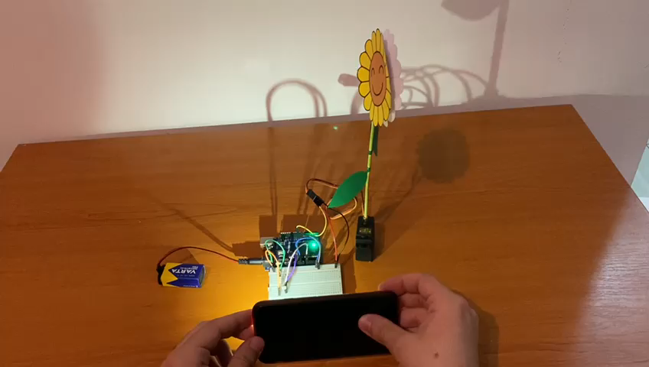
Functionality
The circuit simulates the ability of a (real) sunflower to follow the light using a servo motor and two photoresistors.

Slide 4
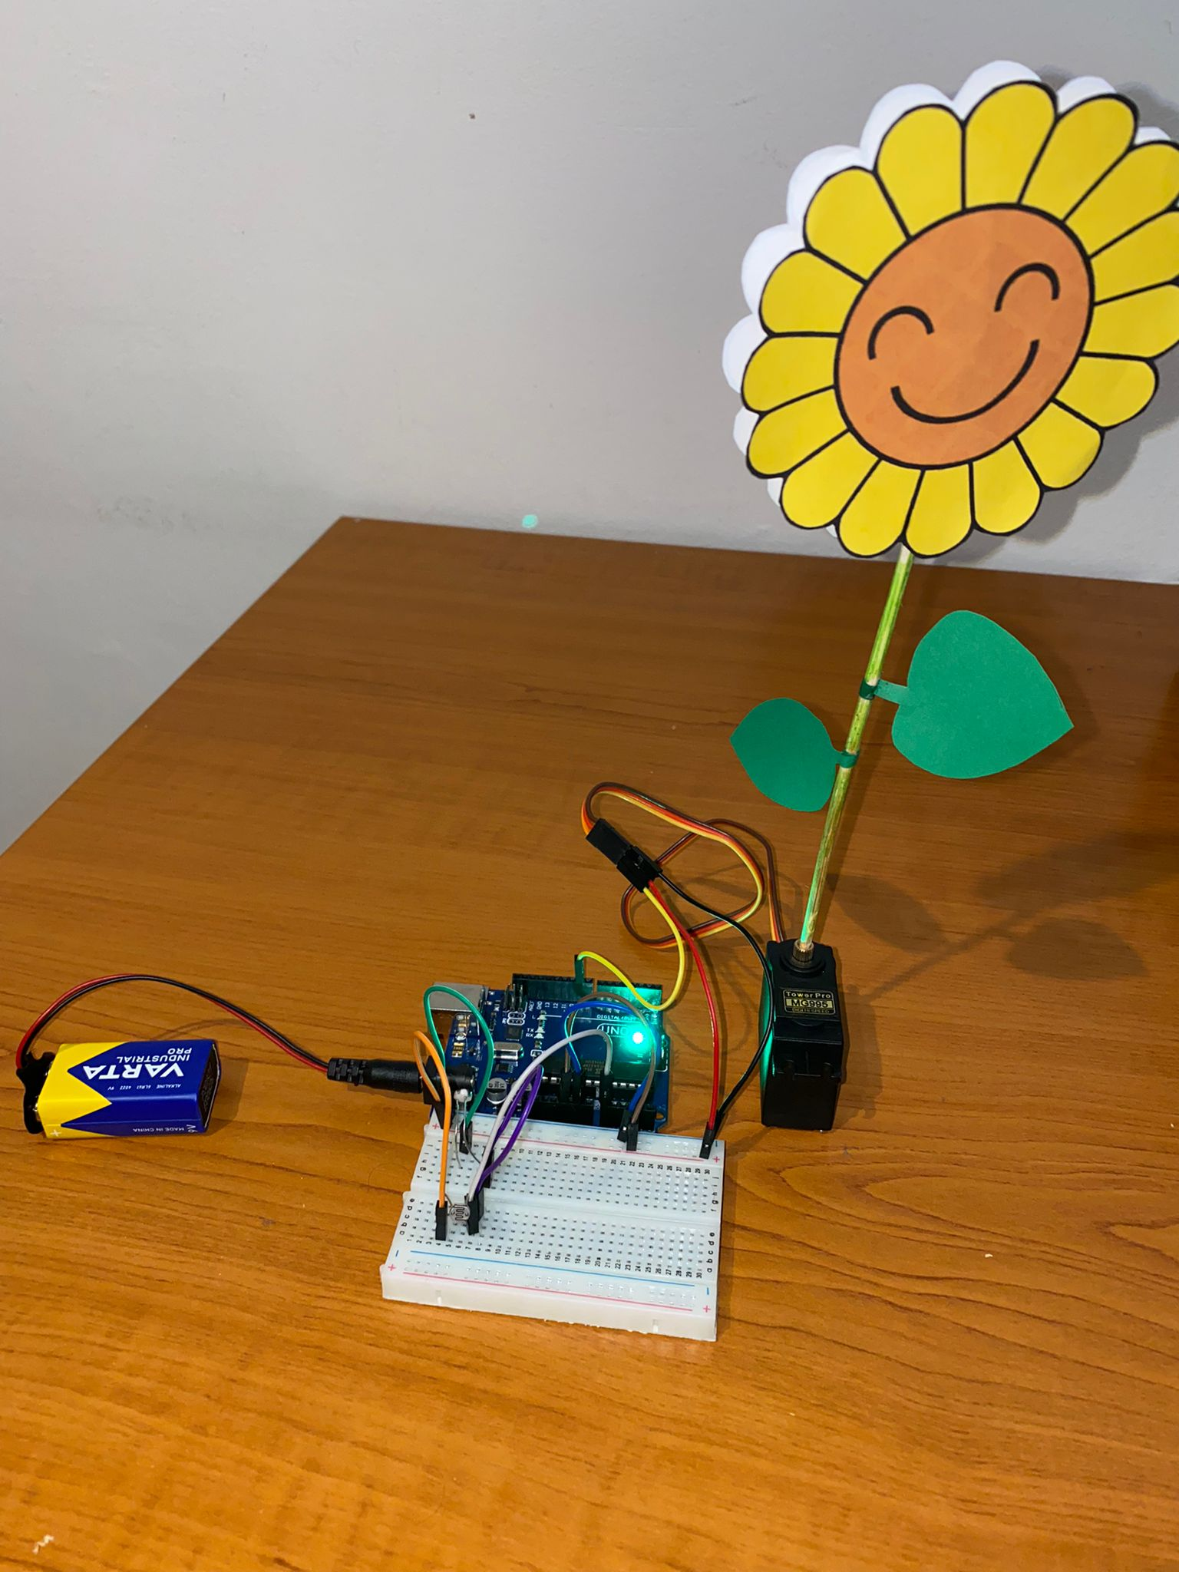
Hardware
Components:
- 1x Arduino UNO
- 1x Breadboard
- 1x Servo Motor
- 2x Photoresistor
- 9x Jumper
- 1x Battery (9V)
- 1x Cute sunflower

Slide 5
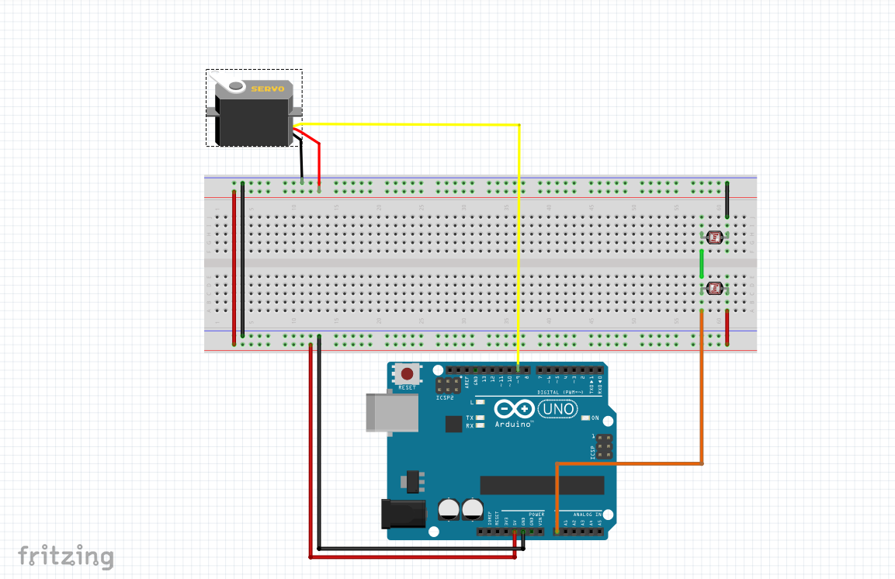
Connections

Slide 6
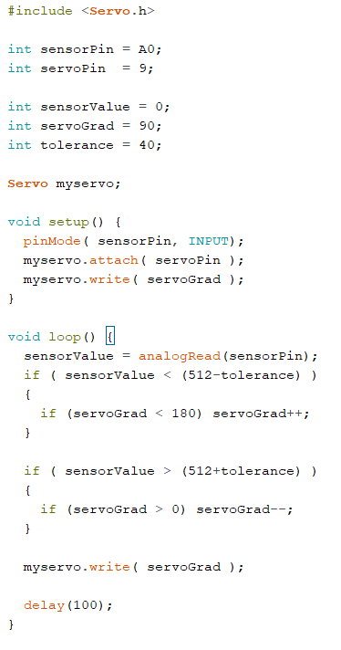
Software
Code – written in C++, then implemented with Arduino 1.8.19

Slide 7
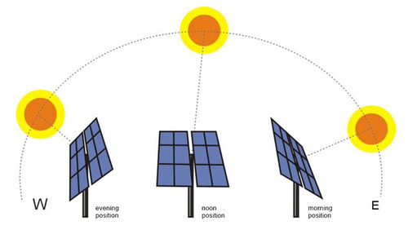
Real-life Usage
The circuit is a prototype of photovoltaic panels which are capable of following the position of the sun for improving their efficiency.

Slide 8


